Slide 1
Global Public Goods, Multilateralism and Justice in Times of Nationalism and Populism
Mandeep Dhaliwal
Director: HIV and Health Group
UNDP

Slide 2
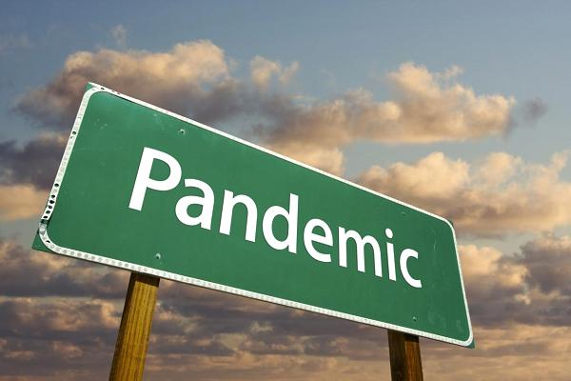
The Global Response to HIV
The response to the worst epidemic the world has ever seen is a powerful global public good
  Solidarity
  Transnational and national alliances across constituencies, sectors, countries
Unprecedented mobilization for a rights- based, people centered response
  People
  Resources
  Laws and policies

Slide 3
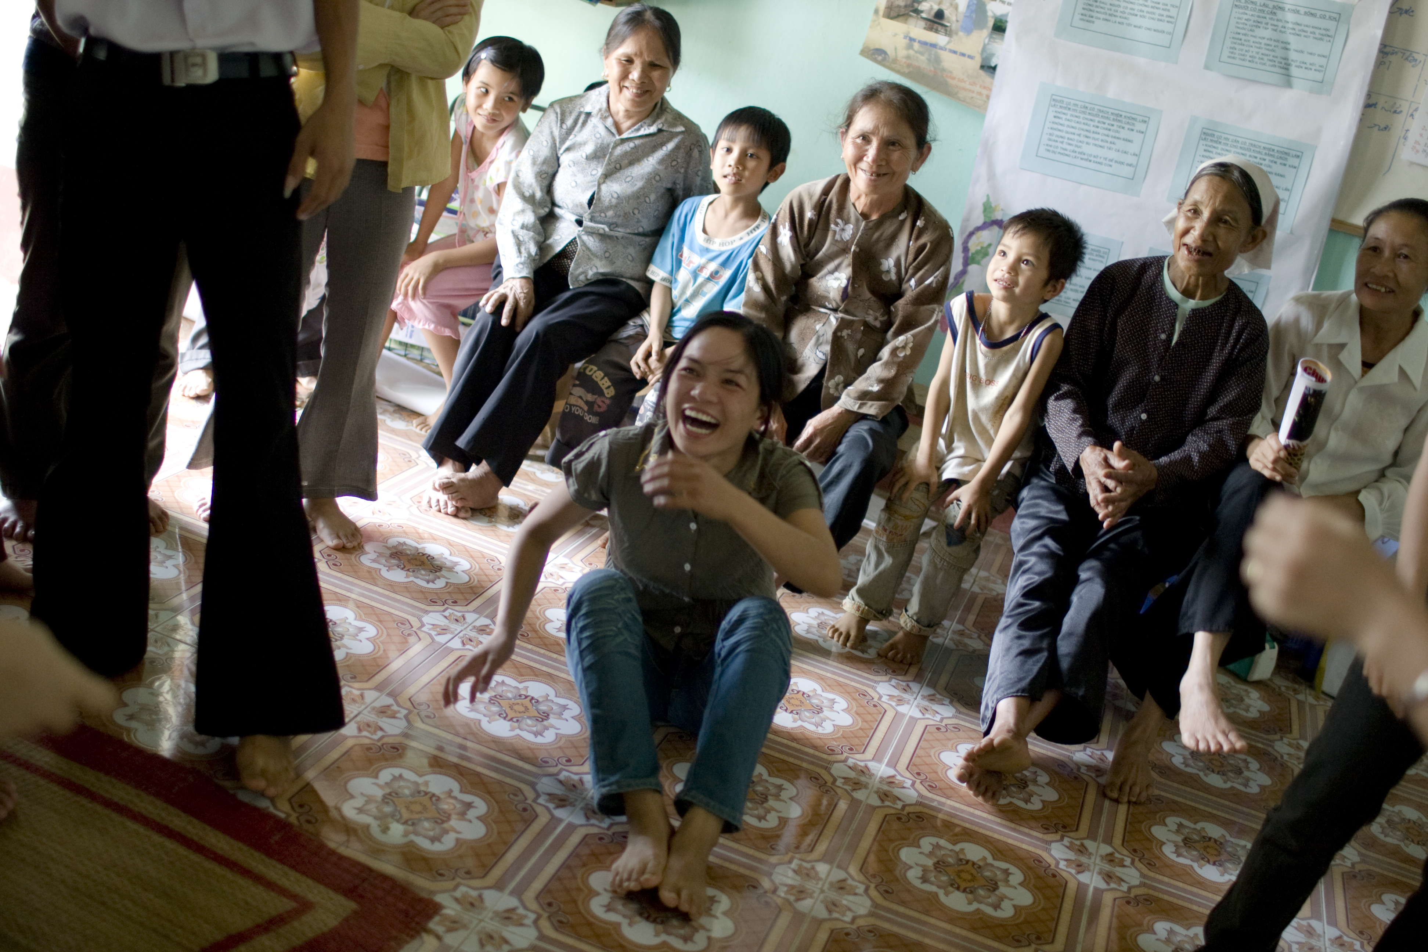
The Global Response to HIV
Persistent challenges
  New HIV infections not decreasing quickly enough
  47% of new HIV infections in key populations and their sexual partners; 33% in young people
  Structural determinants and risks
  Growing inequalities
  Funding: donor funding + domestic financing
  Stifling civil society

Slide 4
Law & Justice
The law, informed by science and grounded in human rights, is a powerful tool to drive inclusion and justice
Repeal laws and practices based on scientific ignorance, bias and irrationality which are impeding effective HIV responses and wasting money

Slide 5
Threats or opportunities
Multilateralism
  A new era of inclusive global cooperation is possible through the 2030 Agenda for Sustainable Development, the Sustainable Development Goals (SDGs) and the pledge to leave no one behind
  New partnerships to address intersectionality; bring new voices to the table
  Credible and responsive leadership to deal with multiple protracted crises and challenges such as migration, xenophobia,

Slide 6

The way forward
The AIDS movement must embrace and drive the 2030 Agenda
  Keep AIDS high on the agenda
  Drive meaningful integration
  (The Lancet – IAS Commission)
  Build a broader movement/coalition for health, well-being and equality

Slide 7
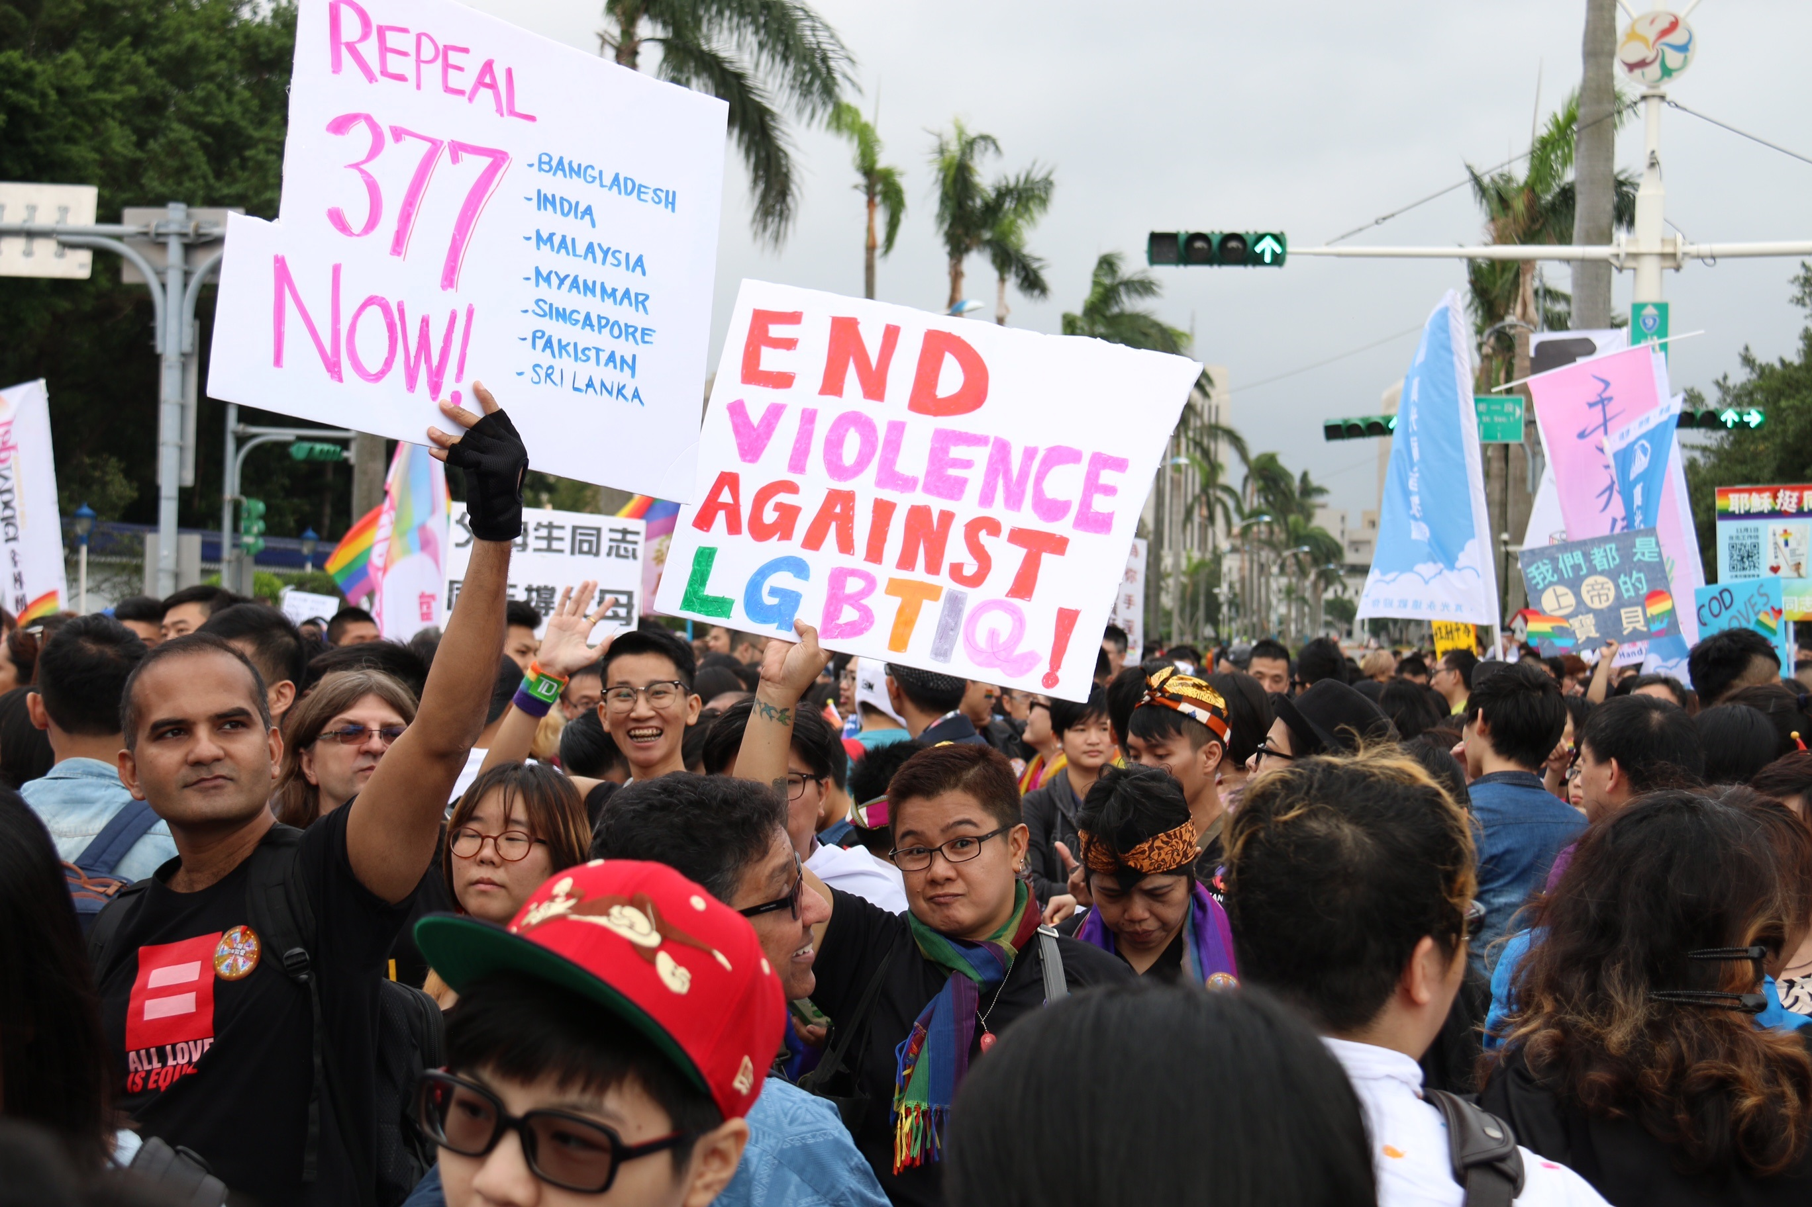
AIDS is still political
Hold governments, donors and the multilateral system to account
Reclaim populism as a force for good
Continue the fight for inclusion, equality and justice

Slide 8
Acknowledgements
Ludo Bok
Karin Santi
The Global Commission on HIV and the Law
Tenu Avafia
Kene Esom
Boyan Konstantinov

